Slide 1
CRYPTOGRAPHY
CS 131
Salvador Gracia

Slide 2
What Is Cryptography?
It provides a secure way to transfer information
Algorithms are used to transform information into ciphertext
Keys along with the algorithms are used to encrypt and decrypt the information
Stops unintended recipients from understanding intercepted information

Slide 3

Asymmetric Encryption
01
02
PUBLIC KEY
PRIVATE KEY
Shared with everyone
Used for encryption
Kept with recipient
Used for decryption

Slide 4
RSA Encryption
Private Key
Public Key
Two big prime numbers are used to decrypt incoming information
282295516061189630578967859130023318662517989552244157837812269150338375241901394795610944762361
282295516061189630578967859130023318662517989552244157837812269150338375241901394795610944762361
Multiply the two big prime numbers from the private key to get the public key
X
=
564591032122379261157935718260046637325035979104488315675624538300676750483802789591221889524722

Slide 5
RSA Encryption
Anyone who doesn’t have the private key will have to factor the public key to find the private key
Modern-day computers would take a really long time to factor if two sufficiently large numbers are chosen

Slide 6
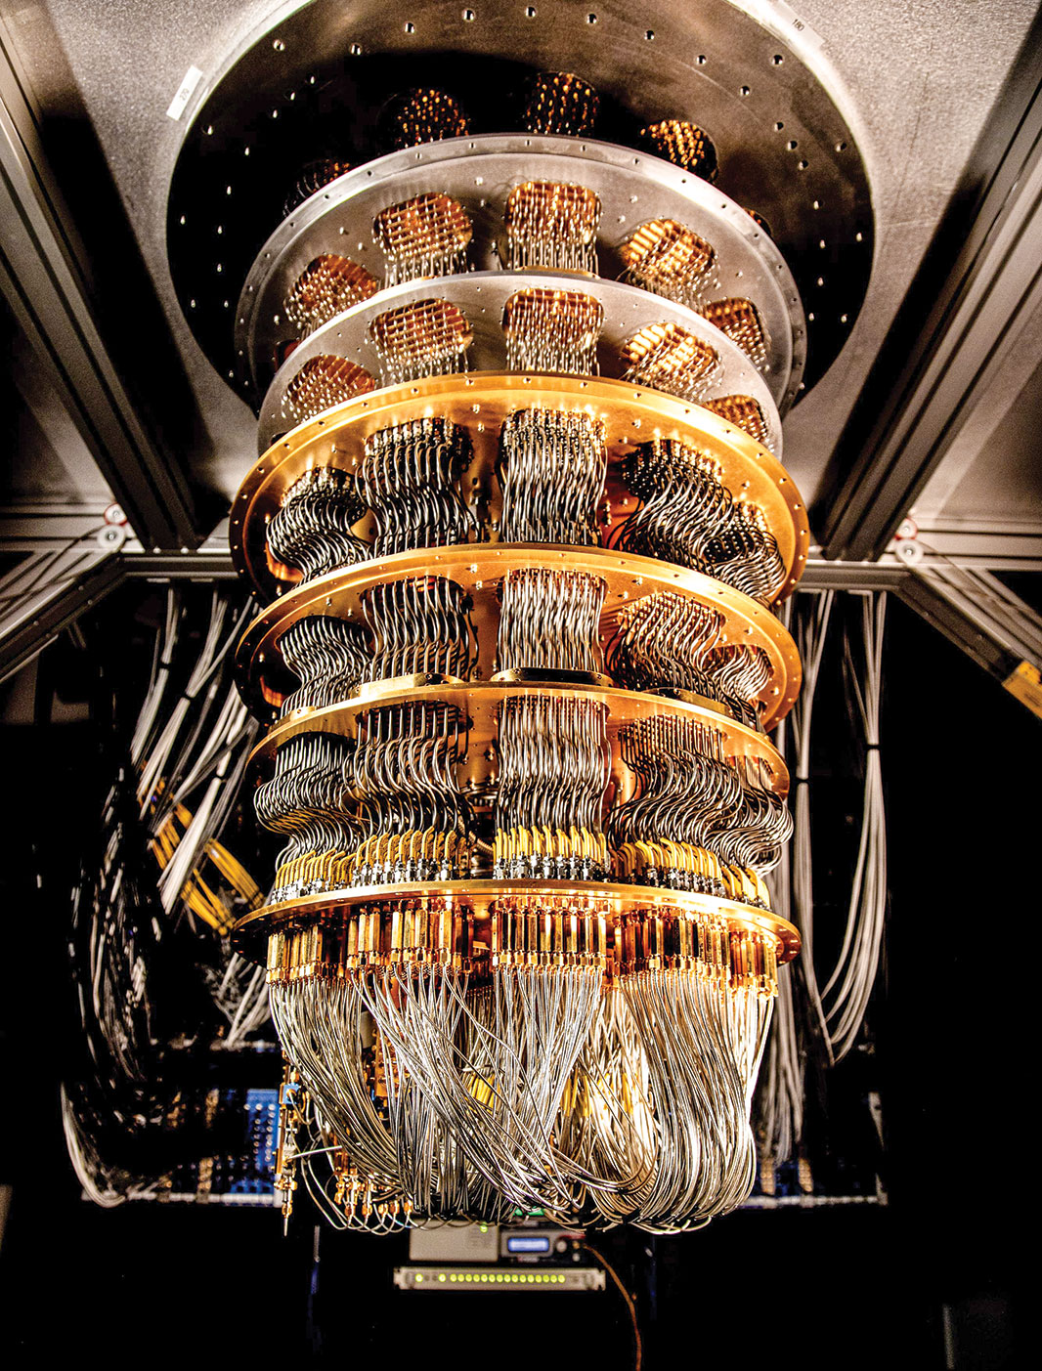
Quantum
Computers
They will have enough computing power to solve public key encryption

Slide 7

Lattice-based Cryptography

Slide 8
Lattice-based Cryptography

Slide 9
Lattice-based Cryptography

Slide 10
Lattice-based Cryptography
As we add more dimensions to our lattice, it becomes harder and harder to solve find the closest lattice point
It’s believed that it will be secure against quantum computers
Multiple encryption methods for post-quantum cryptography use lattice-based encryption

Slide 11
THANKS

